Slide 1


Welcome to Broadband 101

Slide 2
Remember this technology?
Thanks to Sara Nichols, Erica Anderson & Land of Sky Team

Slide 3
Sara gave me three tasks!
Welcome
Importance of endeavor
West Next Generation Network

Slide 4

So -
This Photo by Unknown Author is licensed under CC BY

Slide 5

Importance: Things you already know!
Access to high speed broadband is essential to the future of Western North Carolina!
Telemedicine
Education
Commerce
Tourism
Governmental services
Gigabit speeds are needed
100 Mpbs by 2020 (National plan)
1 Gigabit by 2030
This Photo by Unknown Author is licensed under CC BY-SA

Slide 6

Importance: Things you already know!
Fiber is essential for every part of Western North Carolina!
Area does not want separation of haves and have nots
Fiber is reliable and long lasting
5 G wireless requires fiber backbone
This Photo by Unknown Author is licensed under CC BY-SA

Slide 7

Importance: Things you already know!
Solutions require public/private partnerships
Current approach treats broadband as a private, not public good
Government limits governments providing service
Critical need for data and selling of potential markets for private firms
This Photo by Unknown Author is licensed under CC BY-SA-NC

Slide 8
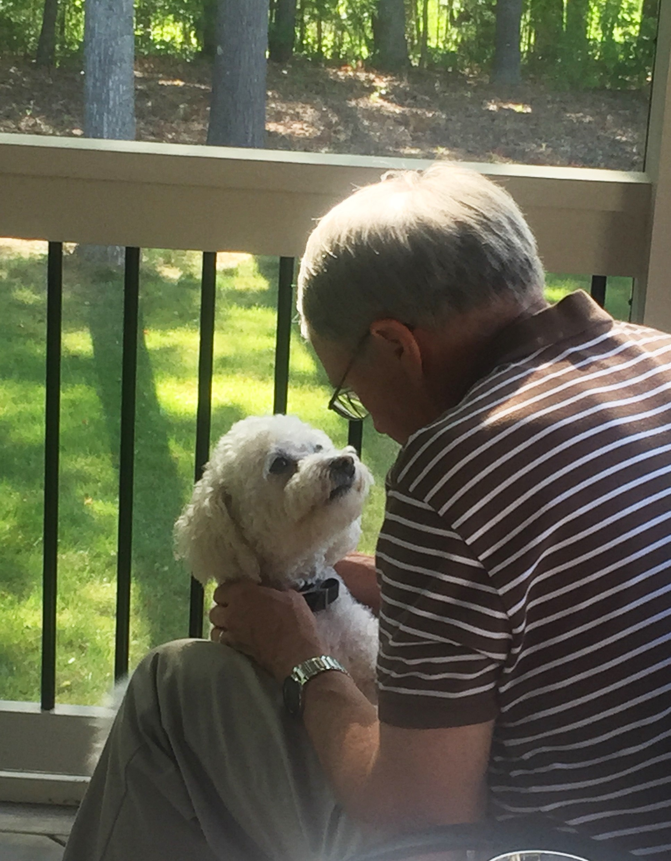

Our approach has been to build upon the work of the NC Next Generation Network organization & use state expertise
My one good picture is back!

Slide 9

WNGN - Two Phases
Hendersonville
Phase 1 – Urban areas along fiber networks with available “dark fiber”
Asheville, Waynesville, Hendersonville, Fletcher, Laurel Park & Biltmore Forest
RiverStreet and Hotwire selected from RFN
Asheville
Laurel Park
Land of Sky
Fletcher
Biltmore Forest
Waynesville

Slide 10
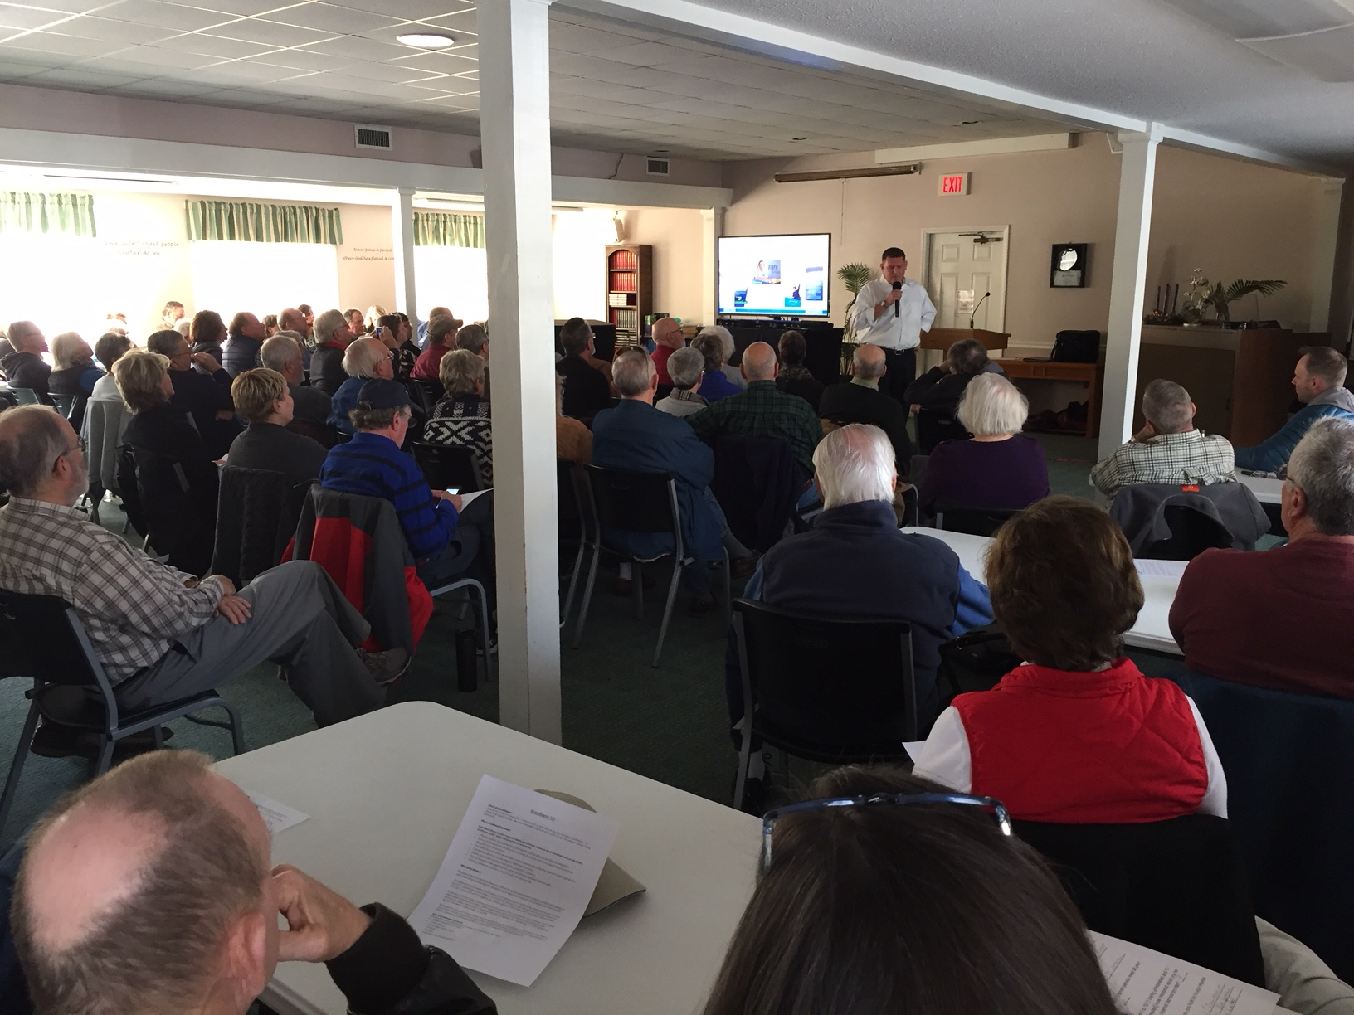
Phase One Update
Public hearings in four cities with RiverStreet
Hendersonville, Fletcher, Laurel Park & Biltmore Forest
Working on getting public feedback about market potential
Asheville – conversations with new city manager
Waynesville – potentially inviting RiverStreet to analyze market
UNCA students developing an App
Laurel Park Public Hearing – Dec. 2018

Slide 11
WNGN - Two Phases
Phase 2 – Less urban areas in Land of Sky service region (Henderson, Transylvania, Buncombe & Madison Counties)
Building local rural capacity
Jeff Sural – NC DIT
Keith Connover
Amy Huffman
(others)
More from Sara and today presenters

Slide 12
Future requires
Collaboration
Innovative strategies
Money

Slide 13
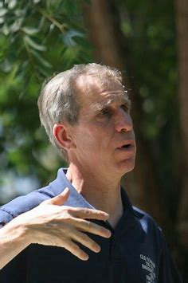
Theme for our future
Fiber on every street
5G cell on every street corner or in every holler
Allows WNC to be competitive!
Theme provided by Stagg Newman – former chief technologist for the FCC.

Slide 14
You all get an A! –
Assuming you pay attention

